Slide 1
Blockchain-Based Battery Traceability System
Implementation
Digital Transformation Team
ZHANG Mingzhe, 118020526
CHEN Honghao, 119010014
LI Jingyu, 118010141
Li Jiaqi, 220041009

Slide 2
Digital Transformation Team
01
Introduction & Background
02
Project Description
Traceability
03
System Implementation
04
Achievement
05
Future Recommendations
Introduction
Description
Impelemntation
Achievement
Future

Slide 3
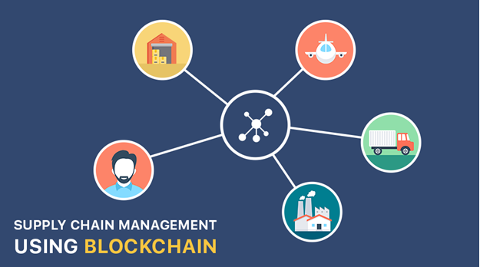
Project Introduction
Digital Transformation Team
01
Introduction
Description
Impelemntation
Achievement
Future

Slide 4
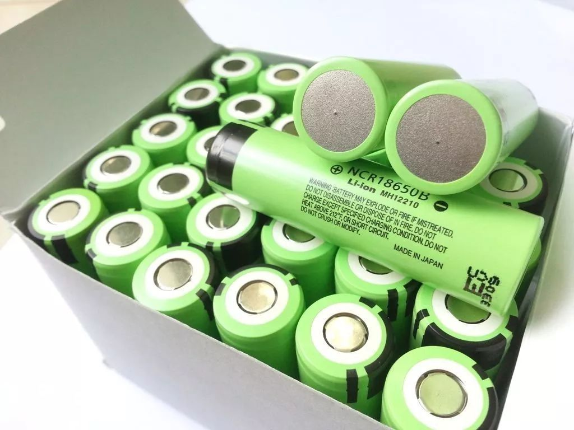
Introduction
Digital Transformation Team
Battery
Need of traceability
Strategic Component
Expensive
Contributes to the major cost
of making tools
Complex
Complicated manufacturing
process
Blockchain-Based
Battery Traceability System
Risk of explosion
Instability of element like Co
Require specific conditions of
storage and transportation
Introduction
Description
Impelemntation
Achievement
Future

Slide 5
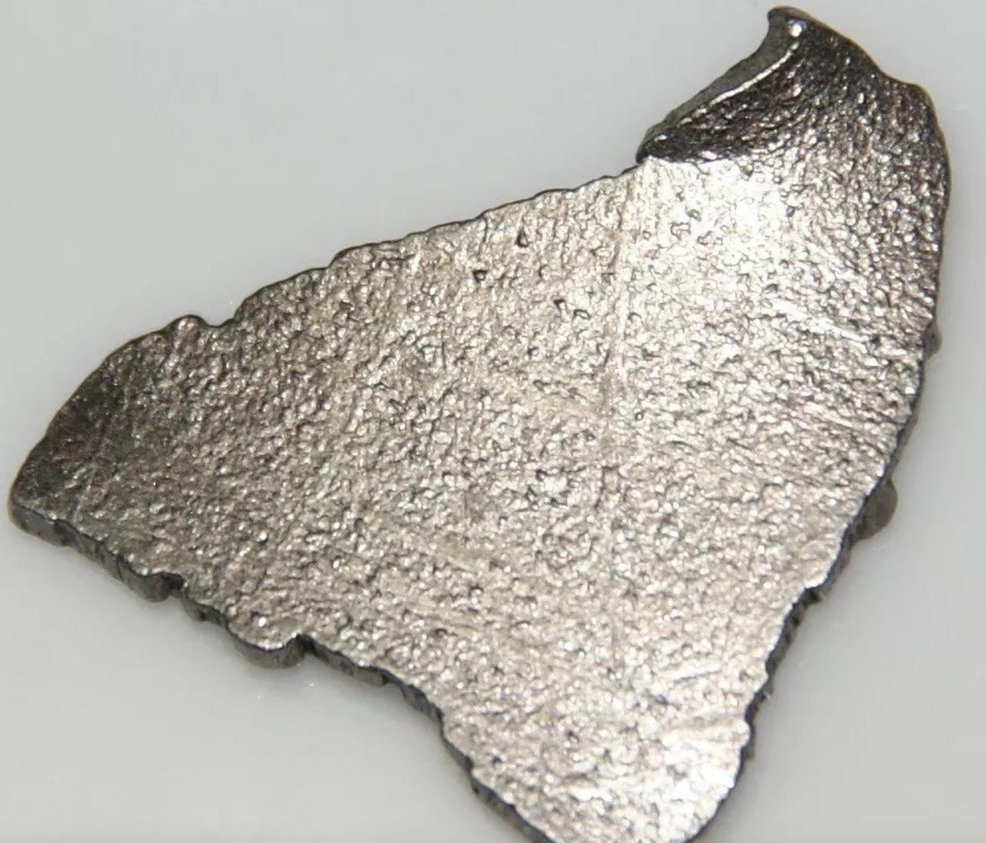

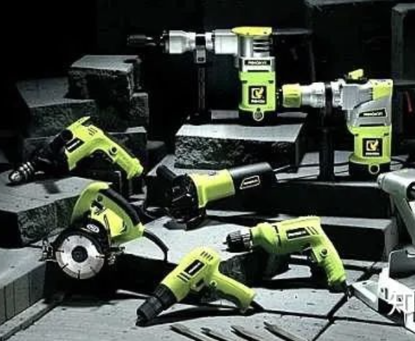

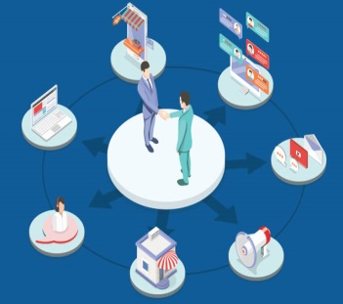
Battery & Electric Tool Supply Chain Overview
Digital Transformation Team
Battery Supplier
Our Sponsor
Logistics Provider
Battery manufacturer
Responsible for safe and one-time delivery
End
Consumers
Raw Material Supplier
Electric Tool Manufacturer
Channel Partners
Iron, Lithium, Cobalt
Produce tools that require battery (sponsor)
Including online & offline distributors, retailers,
Movement of battery
Introduction
Description
Impelemntation
Achievement
Future

Slide 6
Digital Transformation Team
Pain Points
Collusion between battery supplier and
inspection agency
Third-party quality inspection agencies may issue false quality inspection reports. This will allow inferior products to enter the market.
Companies try their best ensure the safety of lithium batteries on the electric power tools. They should supervise the production process in their battery suppliers adequately.
Common mode is that, battery suppliers provide a third-party quality inspection report for electric power companies to prove that their products meet the requirements.
Illegal manipulation
A typical example is the melamine milk incident in the food field.
Possible inferior raw materials of battery itself
For the battery companies themselves, it is difficult to fully guarantee the quality of the raw materials and parts used in the production of batteries..
High Inspection Fees
The quality inspection of lithium batteries requires the manufacturer to pay a fee.
Pain points exist!
Time consuming
manufacturer‘s application → the manufacturer’s mailing of samples → the quality inspection agency‘s quality inspection→ and the mailing of the report after the inspection is completed

Slide 7


Feasibility of Blockchain
Digital Transformation Team
Why not just employ traditional database to share the information?
Central needs
Data Authenticity
Data Consistency
Inconsistent → Different player has different format or content.
Changeable → Easy to edit content.
Consistent → Everyone has the same info
Immutable → Data cannot be modified after upload
Real-time (value-added)
Relational Database
Blockchain
Centralized database
Decentralized database
Introduction
Description
Impelemntation
Achievement
Future

Slide 8
Project Description
Digital Transformation Team
02
Introduction
Description
Impelemntation
Achievement
Future

Slide 9
Data Model - Entities
Digital Transformation Team
Participant
Battery
Raw Material
Battery
Electric Tool
Actors
Assets
Assets
Assets
Introduction
Description
Impelemntation
Achievement
Future

Slide 10
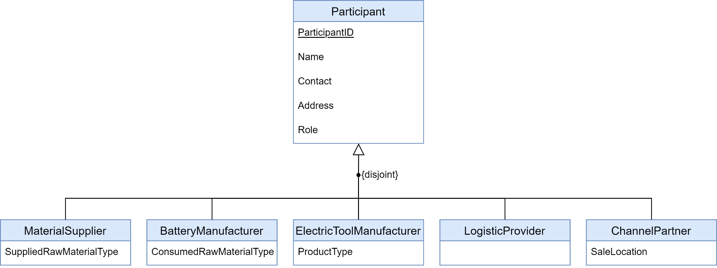



Entities - Participant
Digital Transformation Team
Divided into 5 roles, each with different attributes
Specialization used in design participant entity
Introduction
Description
Impelemntation
Achievement
Future

Slide 11
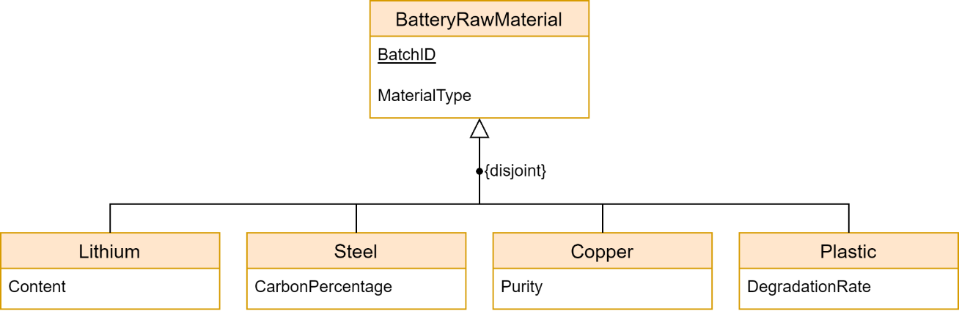
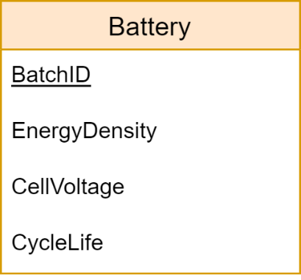
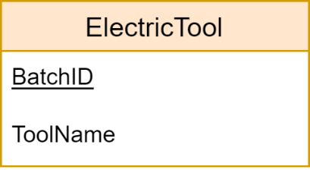
Entities – Assets
Digital Transformation Team
Raw materials
Battery
Electric tool
Different types of raw materials, each with different attributes
Specialization used in design this entity
Introduction
Description
Impelemntation
Achievement
Future

Slide 12
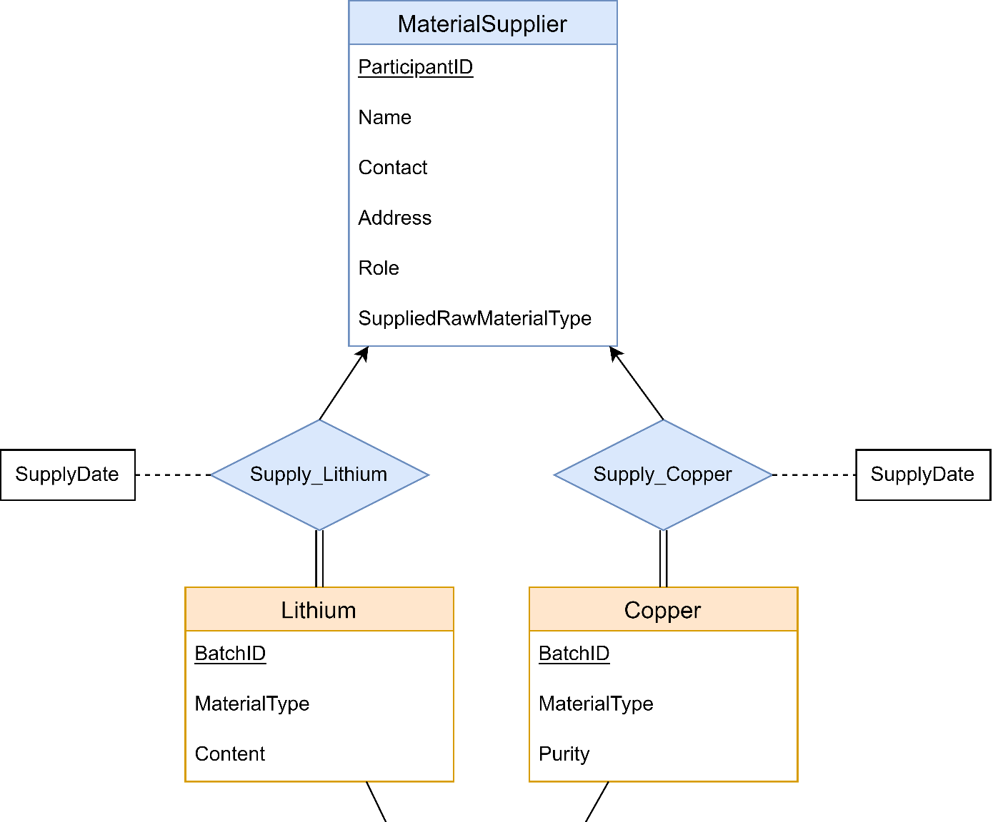
Entity-Relationship Diagram - Supplying Raw Materials
Digital Transformation Team
Relation Type 1
Supplying Raw Materials
Create material in the system
Introduction
Description
Impelemntation
Achievement
Future

Slide 13
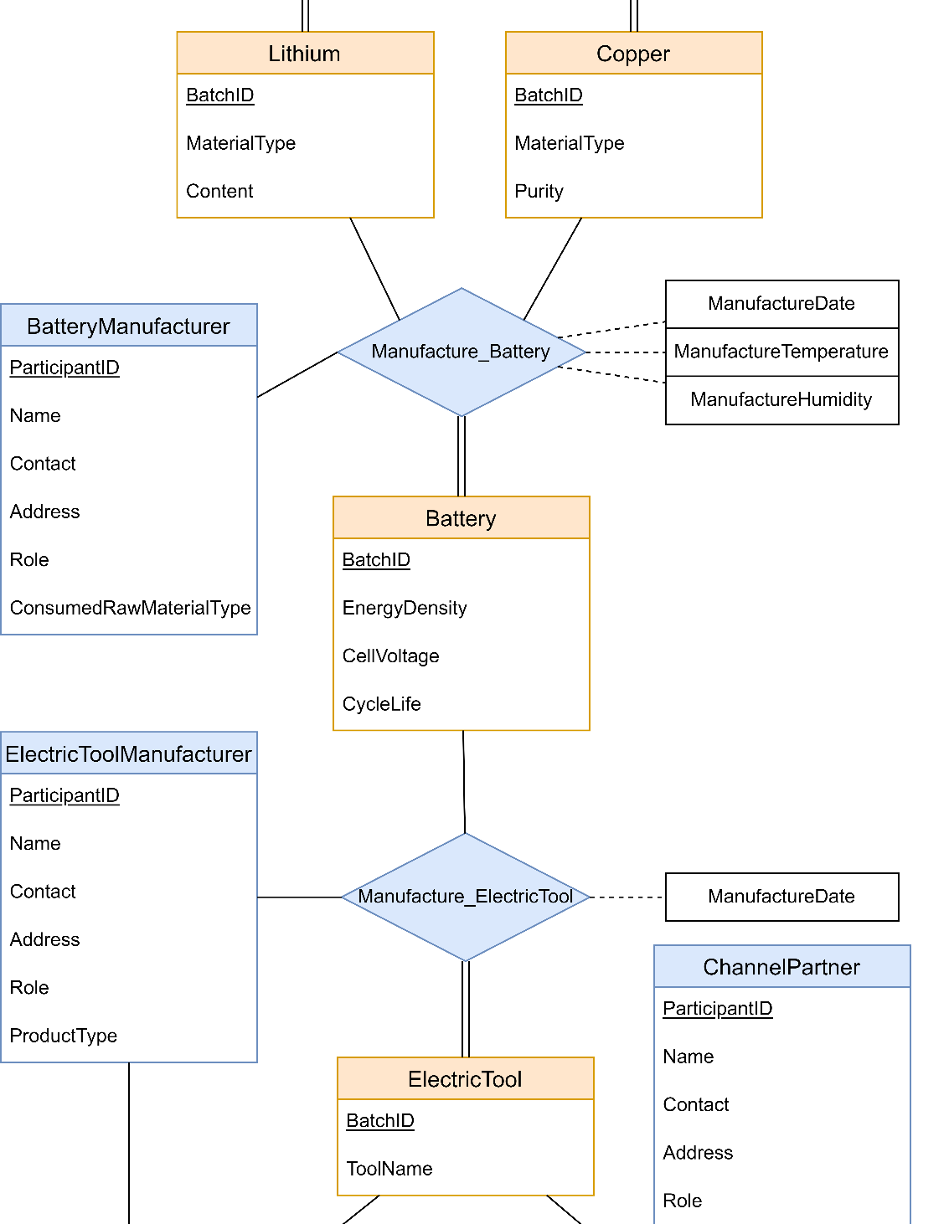
Entity-Relationship Diagram - Manufacturing Battery / Electric Tool
Digital Transformation Team
Relation Type 2
Manufacturing Battery
Transfer materials to Batteries
Relation Type 3
Electric Tool
New entities produced basing on existing entities
Transfer Battery to Electric tool
Introduction
Description
Impelemntation
Achievement
Future

Slide 14
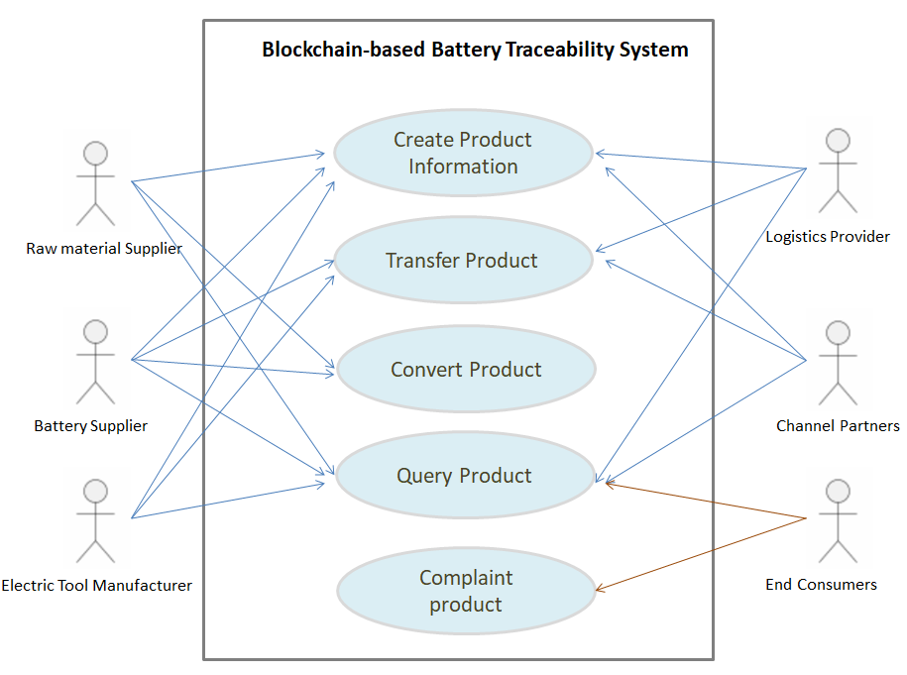
Use Case Diagram
Digital Transformation Team
Introduction
Description
Impelemntation
Achievement
Future

Slide 15
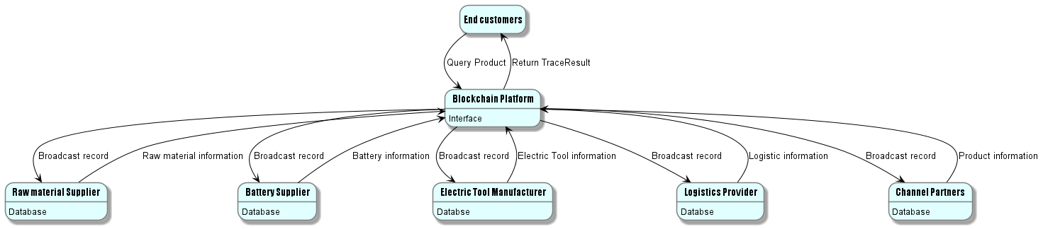
Data Flow Diagram
Digital Transformation Team
1 Platform + 1 Interface + 5 Nodes (participants)
Introduction
Description
Impelemntation
Achievement
Future

Slide 16
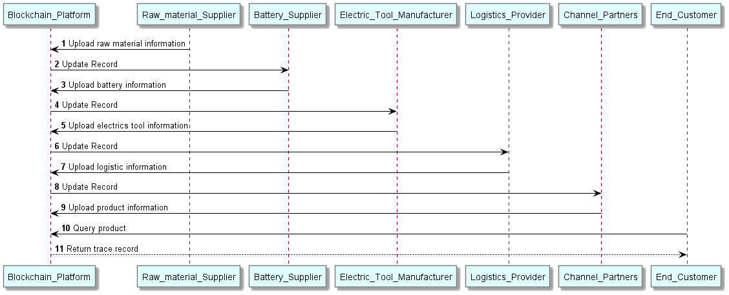
Sequence Diagram of product trace
Digital Transformation Team
Introduction
Description
Impelemntation
Achievement
Future

Slide 17

Implementation
Digital Transformation Team
03
Introduction
Description
Impelemntation
Achievement
Future

Slide 18
Sample Business Workflow
Digital Transformation Team
Participant | Asset | Action
Material Supplier | Raw Material | Create asset information
Battery Supplier | Raw Material, Battery | Convert raw materials to batteries
Electronic Tool Manufacturer | Battery, Electric Tool | Convert batteries to electric tools
Electronic Tool Manufacturer, Logistics Provider | Electric Tool | Transfer electric tools from electronic tool manufacturers to logistics providers
Logistics Provider, Channel Partner | Electric Tool | Transfer electric tools from logistics providers to channel partners
Customer | Electric Tool | Query electric tools information through the supply chain
Introduction
Description
Impelemntation
Achievement
Future
Notes:
Two steps omitted
Deploy smart contract
Initialize all participants

Slide 19
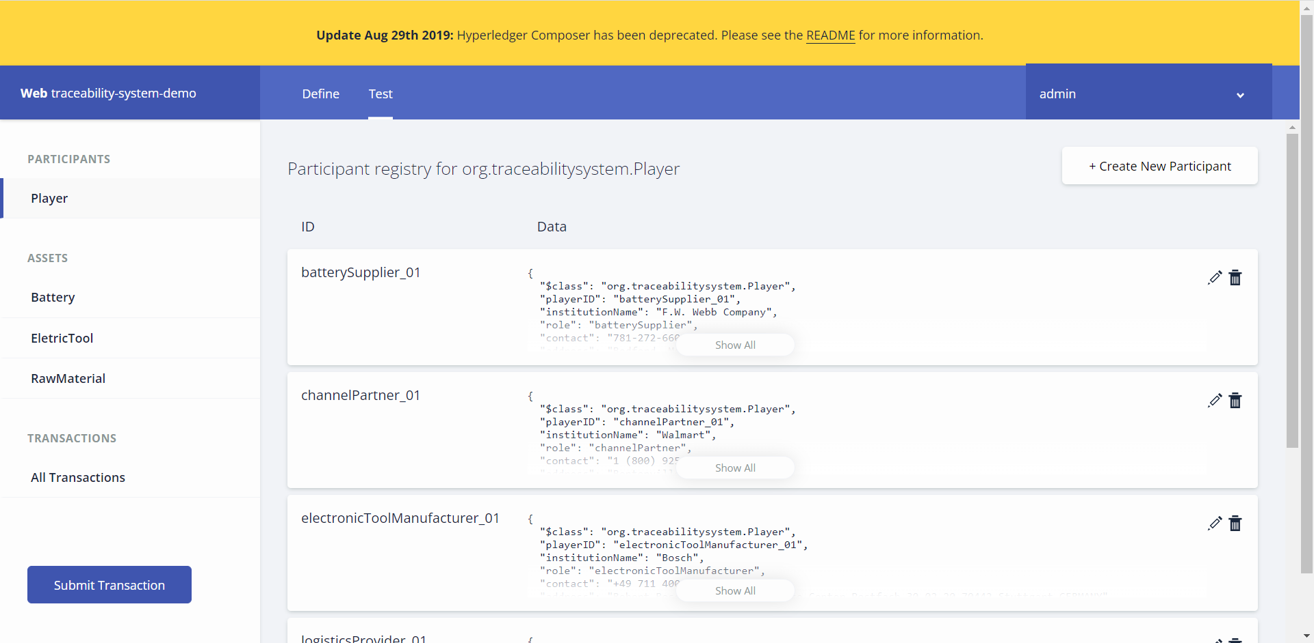
Hyperledger Composer - Participants
Digital Transformation Team
Introduction
Description
Impelemntation
Achievement
Future
Notes:
Two steps omitted
Deploy smart contract
Initialize all participants

Slide 20
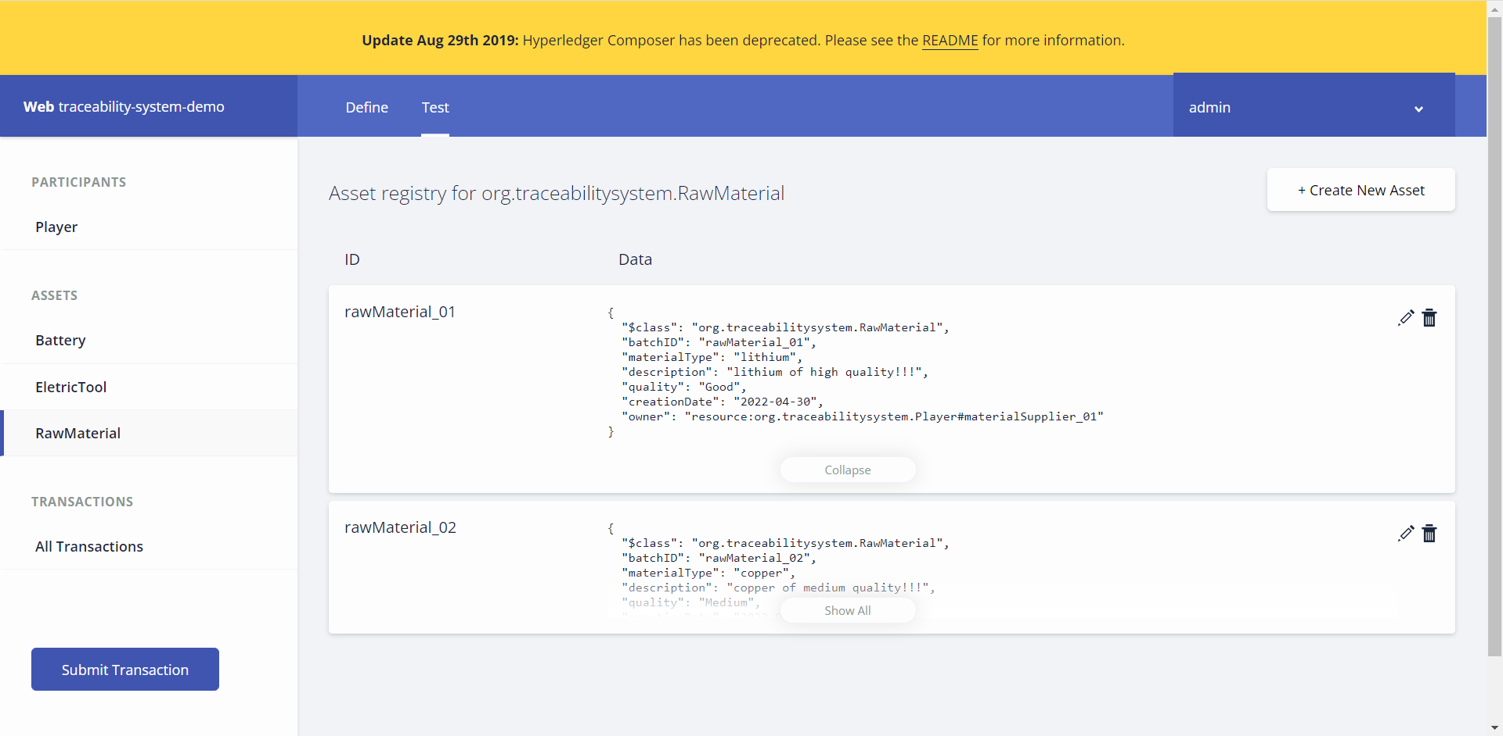
Hyperledger Composer – Raw Materials Created
Digital Transformation Team
Introduction
Description
Impelemntation
Achievement
Future
Notes:
Two steps omitted
Deploy smart contract
Initialize all participants

Slide 21
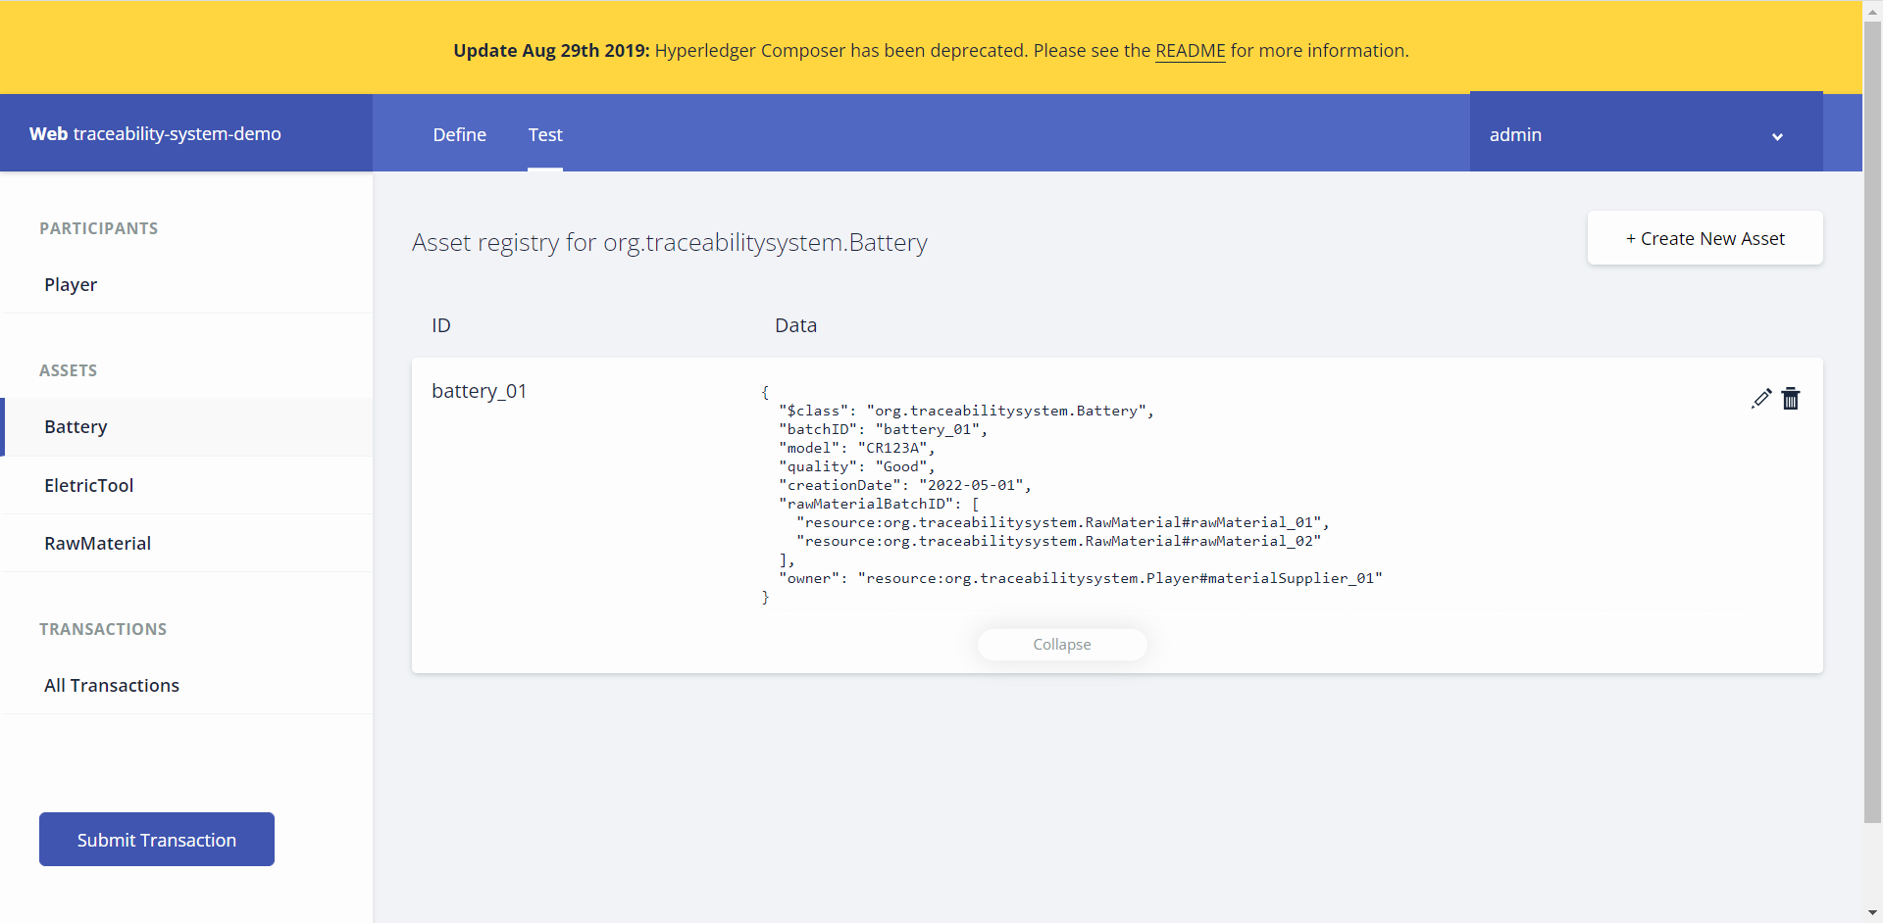
Batteries Converted from Raw Materials
Digital Transformation Team
Introduction
Description
Impelemntation
Achievement
Future
Notes:
Two steps omitted
Deploy smart contract
Initialize all participants

Slide 22
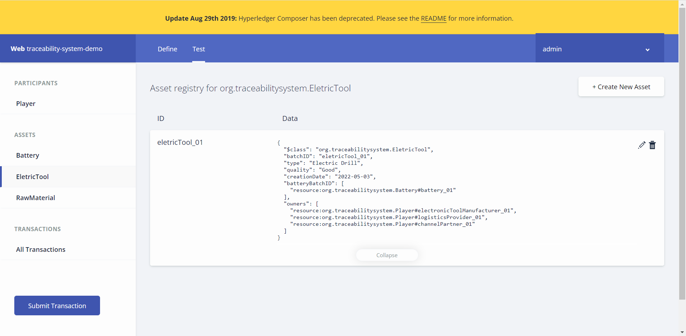
Electric Tools Produced from Batteries and Transferred through the Supply Chain
Digital Transformation Team
Introduction
Description
Impelemntation
Achievement
Future
Notes:
Two steps omitted
Deploy smart contract
Initialize all participants

Slide 23
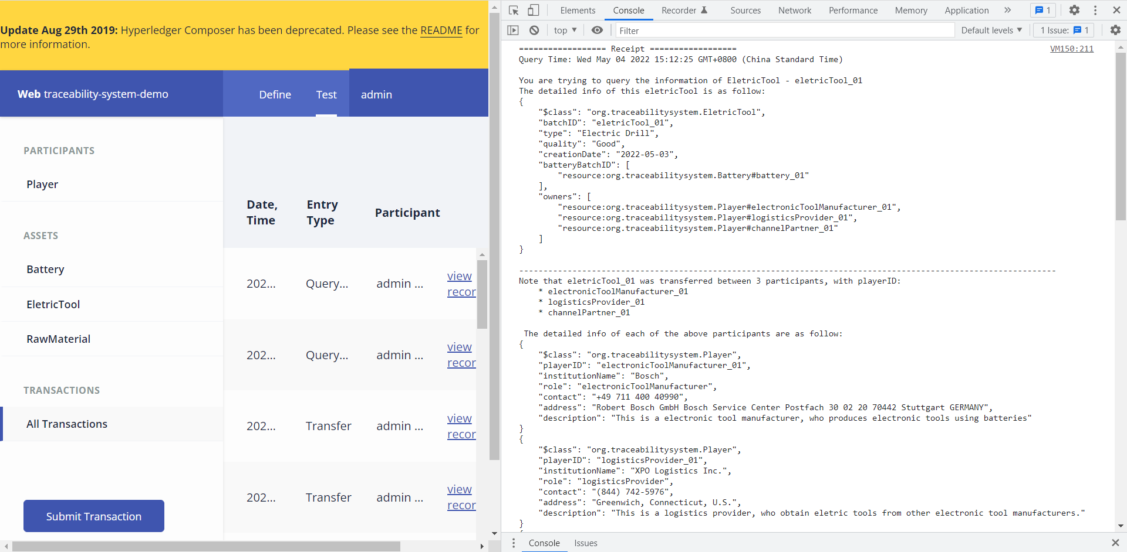
Query Electric Tools Information
Digital Transformation Team
Introduction
Description
Impelemntation
Achievement
Future
Notes:
Two steps omitted
Deploy smart contract
Initialize all participants

Slide 24


Implementation
Digital Transformation Team
03
Introduction
Description
Impelemntation
Achievement
Future

Slide 25
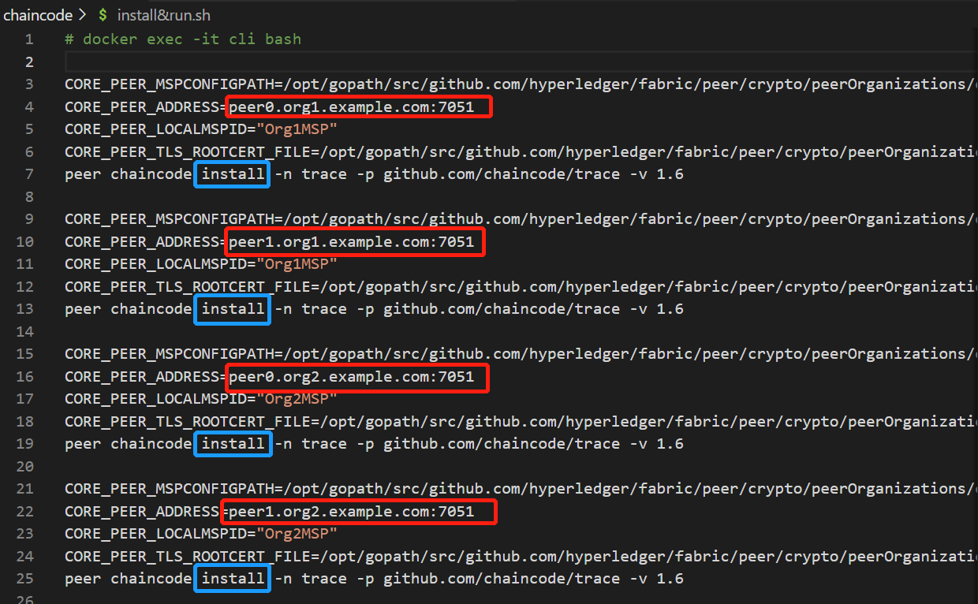
Golang - Deployment
Digital Transformation Team
Install .go chaincode
to 4 peer nodes
Introduction
Description
Impelemntation
Achievement
Future
Notes:
Two steps omitted
Deploy smart contract
Initialize all participants

Slide 26
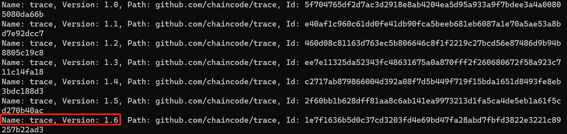
Golang - Deployment
Digital Transformation Team
peer chaincode list –installed
Instantiate OR Upgrade …
peer chaincode list --instantiated -C mychannel
Introduction
Description
Impelemntation
Achievement
Future
Notes:
Two steps omitted
Deploy smart contract
Initialize all participants

Slide 27
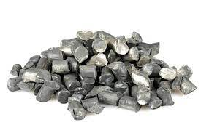
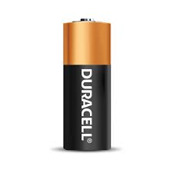
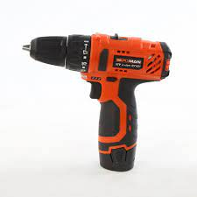
Golang - Asset Attribute
Digital Transformation Team
Attribute | Generation | Sample value
Batch ID | Defined by Participant | MDS0001
Creation Time | Generate automatically | 2022-05-04 12:46:30
Type | Defined by Participant | {raw_material, battery, electric_tool}
Name | Defined by Participant | lithium, copper, lithium_battery, …
Quality | Defined by Participant | {bad, medium, good, perfect}
Description | Defined by Participant | lithium of high quality!!!
Owner ID | Defined by Participant | materialSupplier_01
Owner Contact | Defined by Participant | 110
History Owner ID | Generate automatically | channelPartner_ljy <-- logisticsProvider_chh <-- electronicToolManufacturer_zmz <-- batterySupplier_ljq <-- materialSupplier_01
Introduction
Description
Impelemntation
Achievement
Future
Notes:
Two steps omitted
Deploy smart contract
Initialize all participants

Slide 28
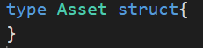
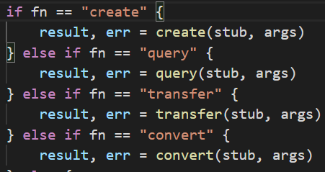
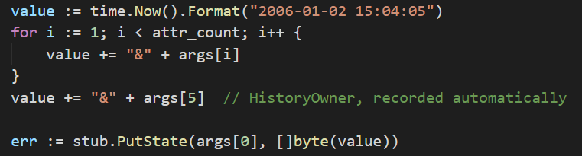
Golang – Code structure
Digital Transformation Team
Define Asset
Invoke function
Initialize the chaincode
Introduction
Description
Impelemntation
Achievement
Future
Notes:
Two steps omitted
Deploy smart contract
Initialize all participants

Slide 29
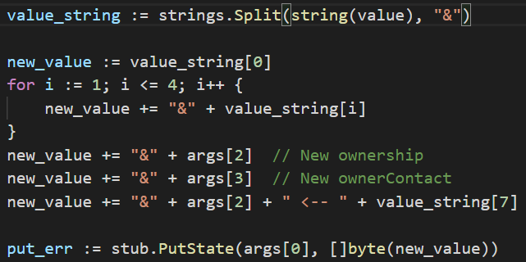
Golang – Code structure
Digital Transformation Team
Create product information
["MDS0002","raw_material","copper","medium","copper of medium quality!!!","materialSupplier_02", "120"]
Transfer product from one participant to another
["MDS0001","materialSupplier_01","batterySupplier_ljq",
"119"]
[BatchID, Original Owner ID, New Owner ID, Owner Contact]
Introduction
Description
Impelemntation
Achievement
Future
Notes:
Two steps omitted
Deploy smart contract
Initialize all participants

Slide 30
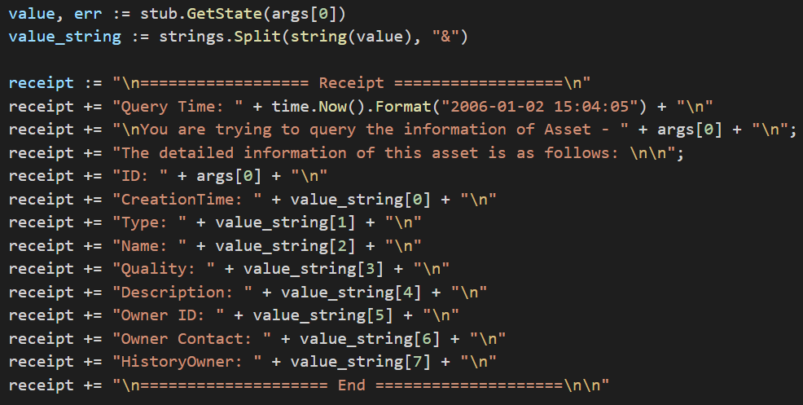
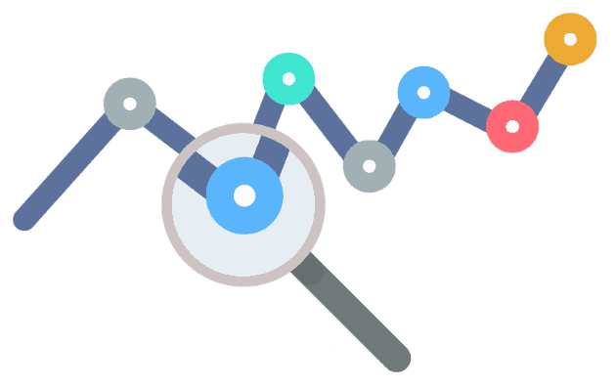
Golang – Code structure
Digital Transformation Team
Covert product type
["MDS0001","battery","electric_tool", "lithum_electric_tool", "Now we have made up the lithum electrical tool"]
[BatchID, Original Type, New Type, New Name, New Description]
Query Product
Introduction
Description
Impelemntation
Achievement
Future
Notes:
Two steps omitted
Deploy smart contract
Initialize all participants

Slide 31
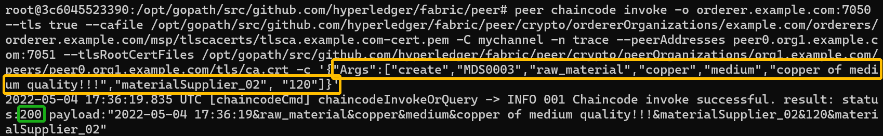
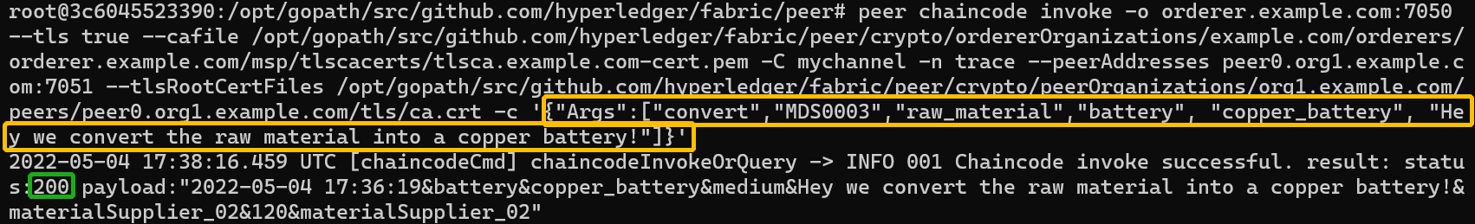
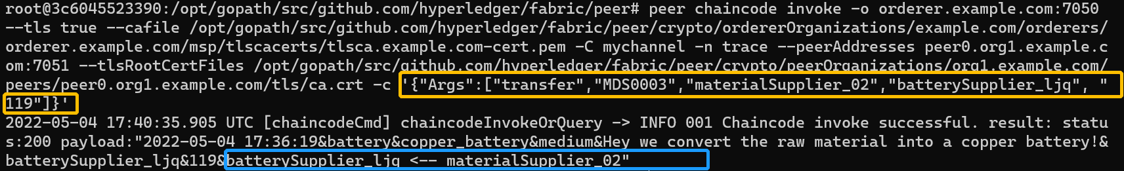
Golang - Result
Digital Transformation Team
Introduction
Description
Impelemntation
Achievement
Future
Notes:
Two steps omitted
Deploy smart contract
Initialize all participants

Slide 32
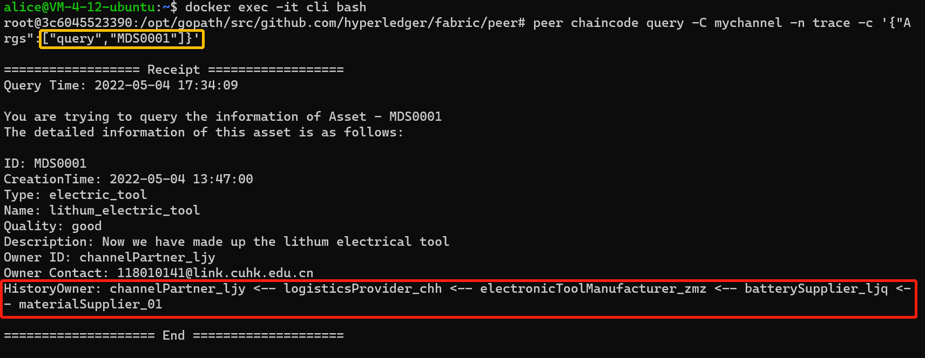
Golang - Result
Digital Transformation Team
Introduction
Description
Impelemntation
Achievement
Future
Notes:
Two steps omitted
Deploy smart contract
Initialize all participants

Slide 33


Golang – Problems Encountered
Install chaincode
to only one node
Difficult to Debug
Not Upgrade
New version code
Pitfall of
Global Variables
……
Wrong Index
access

Slide 34
Achievement
Digital Transformation Team
04
Blockchain-Based Battery Traceability System
Introduction
Description
Impelemntation
Achievement
Future

Slide 35


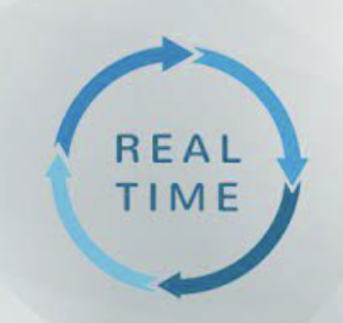
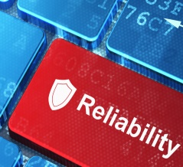
Achievements
Digital Transformation Team
Battery supply chain
Visibility & Responsiveness
Strategical
Real-time and distributed information share
Trust & Partnership
Real-time monitor of orders
Prevent manipulation and collusion.
Enable monitor
of battery
Reliable and extractable
Battery info
Real-time info update among all partners.
Operational
Quality
Position
Strong Query function to
trace root cause.
Introduction
Description
Impelemntation
Achievement
Future

Slide 36


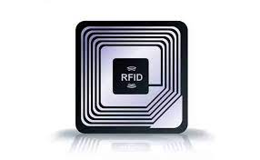
Future Study Recommendations
Digital Transformation Team
05
Introduction
Description
Impelemntation
Achievement
Future

Slide 37
Future Recommendations
Digital Transformation Team
Recom 1 Front-end
Use front-end tools such as Angular
framework (HTML, CSS, Javescript)
Human - Computer Interaction
Recom 2 Data Variety
Increase data variety, attributes, and the authenticity
of data, to achieve more complex contract logic, such
as verifying transfer.
Recom 3
Combine with RFID to realize automated
update of information

Slide 38
Digital Transformation Team
Concluding Remarks
“Every single battery is under control!”

Slide 39
Thank you!

